Slide 1
Generalized IPv6 for VXLAN/GRE
Qiangzhou Gao

Slide 2
Brief summary
As IPv6’s evolution, tunnels like VxLAN, GRE, need to be extended to support new features.
The following choice can be taken into account when design the extension:
As the Internet Architecture Board of the IETF announced in 2016, it is not recommended to support the new features over the IPv4 for these IP tunnels.
It is recommended to reuse the existing IPv6 encapsulations based on the IPv6 extension header when support the new features for these IP tunnels over the IPv6.

Slide 3
GIP6 Encapulation Description
The Generalized IPv6 (GIP6) tunnel is defined to use the IPv6 header and IPv6 extension header to support both existing IP tunnels functions and new features.
A GIP6 encapsulated packet has the following format:
Option 1
+ - - - - - - - - - - - - - - - - - - - - - - - - - - - - - - - - - - - +
| IPv6 Header |
+ - - - - - - - - - - - - - - - - - - - - - - - - - - - - - - - - - - - +
| IPv6 Extension Header |
| (Encapsulations of new features) |
| |
+ - - - - - - - - - - - - - - - - - - - - - - - - - - - - - - - - - - - +
| Existing IP Tunnel Headers |
+ - - - - - - - - - - - - - - - - - - - - - - - - - - - - - - - - - - - +
| Payload packet |
+ - - - - - - - - - - - - - - - - - - - - - - - - - - - - - - - - - - - +
Option 2 (Recommended)
+ - - - - - - - - - - - - - - - - - - - - - - - - - - - - - - - - - - - +
| IPv6 Header |
+ - - - - - - - - - - - - - - - - - - - - - - - - - - - - - - - - - - - +
| IPv6 Extension Header |
| (Encapsulations of new features + |
| Encapsulations of functions of existing IP tunnels) |
+ - - - - - - - - - - - - - - - - - - - - - - - - - - - - - - - - - - - +
| Payload packet |
+ - - - - - - - - - - - - - - - - - - - - - - - - - - - - - - - - - - - +
GIP6 Encapsulation
GIP6 Encapsulation
The Option 1 has the following problems:
1. Redundant Functions: For example, the UDP-based IP tunnel can directly use IPv6 flow label to implement ECMP
2. Separated process of tunnel functions: Some functions use IPv6 extension headers and some functions use headers of tunnels. tunnel processing is separated and complex
3. If the IPSec extension header is used, the tunnel's own header maybe encrypted and unable to be parsed when necessary process is needed.
The advantage of option 1: the existing tunnel headers are retained and it is easy to implement the smooth evolution.
With the option 2, all the instructions are encapsulated in the IPv6 extension headers which will facilitate the unifying process. This option is recommended in the document.

Slide 4
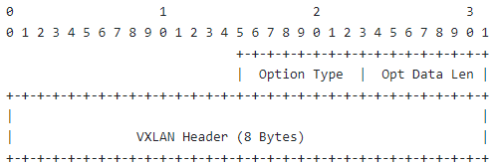
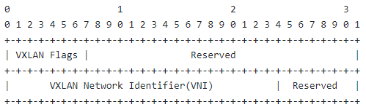
GIP6 for VXLAN
1. The function of the UDP is replaced by the flow label of the IPv6 header in the GIP6 tunnel. To ensure compatibility, the value of the flow label calculated for the purpose of ECMP SHOULD be the same as that of the source port of the UDP.
2. Definition of the VN Option
A new option called VN Option is defined to carry the VXLAN header information. The VN Option MUST only be encapsulated in the Destination Options Header (DOH).
VN Option
VXLAN headers

Slide 5
GIP6 for GRE
The checksum, key information of GRE can reuse the IPv6 Authentication Header (AH).
Definition of the GRE Option
A new option called GRE Option is defined to carry the GRE header information. The GRE Option MUST only be encapsulated in the Destination Options Header (DOH).
GRE Option
GRE

Slide 6
Generalized IPv6 for MPLS
Zhenbin Li

Slide 7
Technical Challenges to MPLS
MPLS is lack of the source indication and MP2P connections may occur. This causes the difficulty and complex process for OAM over MPLS. Although SFL( [RFC8957]) is defined, there is few implementation.
The payload type (for example, L2 or L3 packets) cannot be directly determined because there is no payload indication.
There is no metadata extensibility and it is difficult to encapsulate new forwarding attributes for the new features such as IETF network slicing, IFIT, and APN.
The process of the ECMP function is complex and affects forwarding performance. Entropy labels or flow labels are placed at the bottom of the label stack for processing and the internal IP header information may have to be parsed for the purpose of ECMP.
MPLS Label Encap
Label
TC
S
TTL
20
bits
3
bits
1
bit
8
bit

Slide 8
MPLS Extensions
MPLS needs to be extended to support new functionalities.
Network Slicing
IOAM
DetNet
APN
MPLS Extensions
ISD: In-stack data
PSD: Post-stack data
Challenges
It is not compatible with the existing MPLS network.
Repeated work like the IPv6 extension mechanisms.
Tunnel Label 1
…
Tunnel Label m
Sub-stack Indicator
Network Action indicator
+
Optional Ancillary Data
ISD
NAS
Tunnel Label n
VPN Label （S=1）
PSD
Network Action indicator
+
Optional Ancillary Data
Payload

Slide 9
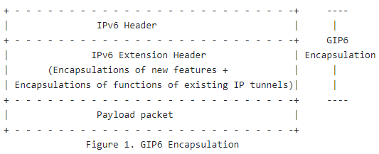
GIP6 tunnel for MPLS
Draft-li-rtgwg-generalized-ipv6-tunnel defines the GIP6 tunnel to support both new features(iOAM/APN…) and the existing functions for the IP tunnels based on the extension of the IPv6 extension header.
If the GIP6 tunnel is used for MPLS, there can be the following advantages:
1. The IPv6 source address is used to form a source identifier.
2. The IPv6 NH can indicate the payload type.
3. IPv6 flow labels are used to implement ECMP.
4. The encapsulations for the new features have been defined well in the IPv6 and can be reused easily.

Slide 10
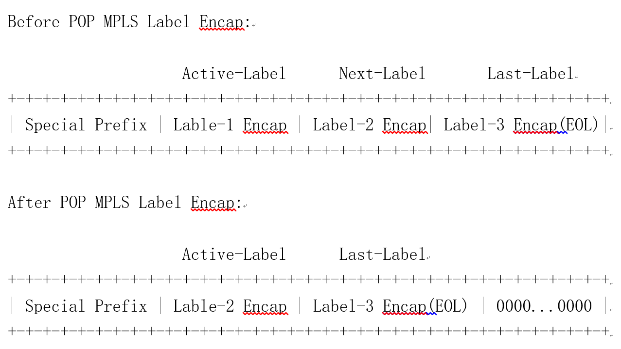
IPv6 MPLS SID(Type 1) can be placed in the IPv6 destination address
Processing of the first label following the special prefix is as follows:
(1) If the local action of the MPLS label is POP, the followed label encapsulations are shifted left by 32 bits after the label is popped. The following figure shows the process.
(2) If the local action of the MPLS label is SWAP, the label encapsulation is changed to the new label after swap.

Slide 11
IPv6 MPLS SID(Type 2) can be placed in the IPv6 RH
If all the MPLS label stack cannot be placed in the IPv6 destination address, IPv6 RH can be used to house the remaining MPLS label stack.
(1) IPv6 MPLS SID (Type 2) is defined to house multiple (<= 4) label encapsulations. The format of the IPv6 MPLS SID (Type 2) is shown in the following figure.
0 1 2 3
0 1 2 3 4 5 6 7 8 9 0 1 2 3 4 5 6 7 8 9 0 1 2 3 4 5 6 7 8 9 0 1
+-+-+-+-+-+-+-+-+-+-+-+-+-+-+-+-+-+-+-+-+-+-+-+-+-+-+-+-+
| MPLS Label Encap (4 octets) |
+-+-+-+-+-+-+-+-+-+-+-+-+-+-+-+-+-+-+-+-+-+-+-+-+-+-+-+-+
| MPLS Label Encap (4 octets) |
+-+-+-+-+-+-+-+-+-+-+-+-+-+-+-+-+-+-+-+-+-+-+-+-+-+-+-+-+
| MPLS Label Encap (4 octets) |
+-+-+-+-+-+-+-+-+-+-+-+-+-+-+-+-+-+-+-+-+-+-+-+-+-+-+-+-+
| MPLS Label Encap (4 octets) |
+-+-+-+-+-+-+-+-+-+-+-+-+-+-+-+-+-+-+-+-+-+-+-+-+-+-+-+-+
(2) IPv6 MPLS SID (Type 2) is used as the segment in the RH. After all of the label encapsulations in the IPv6 destination address are popped, the first label encapsulation in the segment indicated by the SL of the RH will be processed.

Slide 12
Thank You

